Slide 1
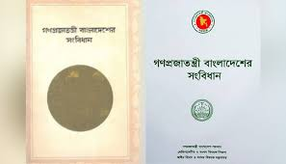
Constitution of Bangladesh
Dr. Ehteshamul Haque
Senior Lecturer, Bangladesh Studies
Software Engineering (SWE)
Daffodil International University

Slide 2
Objectives of this Class
Conceptual analysis of constitution
Introduction of various types of Constitution
Essentials for making a good constitution
Explore the historical background
Identify some common features of the constitution of Bangladesh
Examine some problems in the study of Constitution of Bangladesh
Investigate the key amendments of Bangladesh constitution.

Slide 3
Constitution: Concept
In the modern world, constitution is the sine-qua-non for any country to operate its all sort of functions properly. It lays down rules regarding the organization, powers and functions of government. It also defines the basic features of the State and the relation between the citizens and the State.
“Constitution is the collection of principles according to which the power of the government, the rights of the governed and the relation between the two adjusted.” - Woolsey
“Constitution is a set of established rules embodying and enacting the practice of government”. –Lord Bryce

Slide 4
Cont….
" Constitution of a state is that body of rules or laws, written or unwritten which determine the organization of government, the distribution of powers to the various organs of government and the general principles on which these powers are to be exercised." –Gilchrist

Slide 5
Types of Constitution
Written Constitution: which means a constitution written in the form of a book or a series of documents combined in the form of a book.
Non-Written Constitution: which is neither drafted nor enacted by a Constituent Assembly and nor even written in the form of a book.
Flexible Constitution: which can be easily amended without any terms of condition.
Non-Flexible or Rigid Constitution: which cannot be easily amended. For amending it, the legislature has to pass an amendment bill by a specific, usually big, majority of 2/3rd or 3/4th.

Slide 6
Types of Constitution…
Evolved Constitution: which is not made at any time by any assembly of persons or an institution but the result of slow and gradual process of evolution. Its rules and principles draw binding force from the fact of their being recognized as ancient, historical, time-tested and respected customs and conventions.
Enacted Constitution: which is a man-made constitution. It is made, enacted and adopted by an assembly or council called a Constituent Assembly or Constitutional Council. It is written in the form of a book or as a series of documents and in a systematic and formal manner. The Constitutions of India the USA, Japan, China and most of other states are enacted constitutions.

Slide 7
Qualification for an Ideal Constitution
Constitution must be systematically written.
It should enjoy supremacy.
It should have the ability to develop and change in accordance with the changes in the environment and needs of the people.
It should be neither unduly rigid nor unduly flexible.
It must provide for Fundamental Rights and Freedoms of the people.
It should clearly define the organization, powers, functions ,inter-relations of the government of the state and its three organs.

Slide 8
Cont…
It must provide for the organization of a representative, responsible, limited and accountable government.
The language of the constitution should be simple, clear and unambiguous
The Constitution must clearly reflect the sovereignty of the people.
It must provide for: a) Rule of Law b) De-centralization of powers, c) Independent and powerful Judiciary, d) A system of Local self-government, e) A Sound Method of Amendment of the Constitution, f) Process and Machinery for the conduct of free and fair elections.

Slide 9
Historical background of BD Constitution
Time | Event
23 March 1972 | The president issued the Constitution Assembly of Bangladesh Order, 1972.
10th April 1972- | Constituent Assembly held its first meeting. 404 (out of 469) Assembly members took part in the proceedings.
11 April 1972 | Constitution Drafting Committee was formed consisting of 34 members which chaired by Dr. Kamal Hossain where Razia Banu was only female person.
12 October 1972 | The Constitution Bill was introduced in the Assembly for consideration.
04 November 1972 | The Constitution of Bangladesh was formally adopted by the national assembly.
16 December 1972 | The constitution came into force. The Constitution has 153 Articles arranged under eleven parts and 4 schedules.

Slide 10

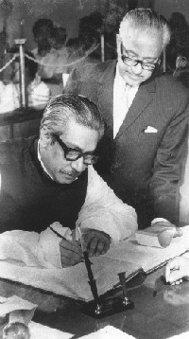
Prime Minister Sheikh Mujibur Rahman signs the Constitution of Bangladesh into law on 16 December 1972.

Slide 11
Bangladesh Constitution: At a Glance
The constitution of Bangladesh has 11 parts, 153 articles, one preamble and seven schedules. It has brought 17 times changes in the constitution of Bangladesh till today.

Slide 12
Common Features of BD Constitution
Rigid Constitution: The Constitution of Bangladesh is rigid one. An amended can be passed only by votes of two-thirds members in the total members of parliament.
Written Constitution: The Constitution of the people Republic of Bangladesh is a written document.
Preamble: The constitution of Bangladesh starts with a preamble which is described as the guiding star of the Constitution.
Supremacy of the Constitution: Supremacy of the Constitution has been ensured by the Article 7 of the Constitution.
Unitary Government System: Article 1 of the Constitution provides that Bangladesh is a unitary people’s republic.

Slide 13
Common Features of BD Constitution
Unicameral Legislature: Article 65 of the Constitution provides Unicameral Legislature for Bangladesh. It is only one house, which known as “House of the Nation”.
Fundamental Principle of State Policy: Article 8 of the Constitution provides for four major fundamental principle of state policy. a)Nationalism b)Democracy c)Socialism d)Secularism
Fundamental Rights: Part III of the Constitution provides for 18 fundamental rights. The enjoyment and enforcement of those rights have been guaranteed in the Constitution.

Slide 14
Common Features of BD Constitution
Parliamentary form of Government: The Constitution of Bangladesh provides for a Westminster type of parliamentary system. This form of government means that the government is run by cabinet of Ministers headed by the Prime Minister.
Independence of Judiciary: The Constitution of 1972 ensured the independence of Judiciary by the Article 22.
Provisions for Ombudsman: Provisions for the establishment of an Ombudsman were inserted in Article (77) to provide machinery to overview the activities of civil bureaucracy, to eradicate corruption in the administration
Responsible Govt. not ensured: Article 55(3) provides that the cabinet shall be collectively responsible to the parliament; this responsibility cannot be ensured in practice due to the barrier created by the Article 70 of the Constitution.

Slide 15
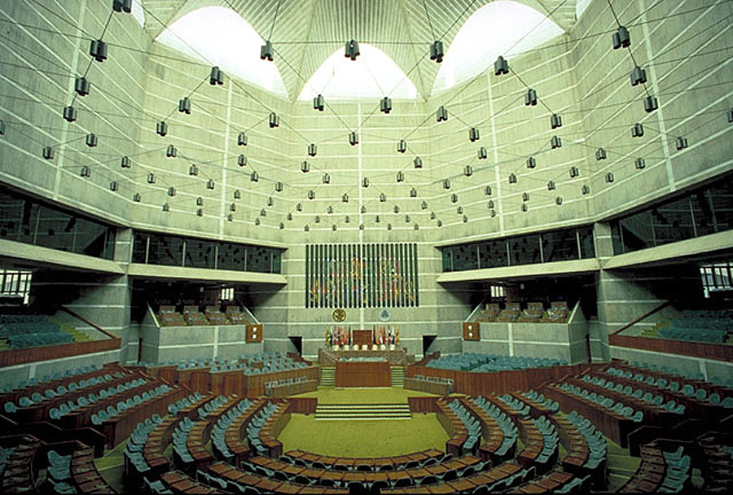
Insight of the Jatiyo Sangsad

Slide 16
Fundamental Principles of Bangladesh
Fundamental principles of state policy indicate those principles which are used as a guideline in formulating different policies. The fundamental principles have been stated in Article-8.
Nationalism: Nationalism which has been achieved from the culture, belief and struggle of the war of independence. (Article 9)
Socialism: In order to avoid the extortion of wealth and economic imbalance, socialism has been taken as fundamental principles of state policy. (Article 10)
Democracy: To ensure the human rights and people's participation, democracy has been included as a fundamental principle of state policy in Bangladesh. (Article 11)
Secularism: Constitution gives the freedom of religion and prohibits the abuse of religion in the name of politics. (Article 12)

Slide 17
Fundamental Rights of the citizen
The Fundamental Rights listed in the Bangladesh Constitution may be classified into following groups:
Absolute Rights:
Equality before law (Article 27)
Discrimination on grounds of religion (Article 28)
Equity of opportunity in public employment (Article 29)
Prohibition of foreign titles (Article 30)
Safeguards as to arrest and detention (Article 33)
Prohibition of forced labor (Article 34)
Protection in respect of trial and punishment (Article 35)
Enforcement of Fundamental Rights (Article 44)

Slide 18
Fundamental Rights of the citizen
B. Rights on which reasonable restriction can be imposed:
Freedom of movement (Article 36)
Freedom of Assembly (Article 37)
Freedom of Association (Article 38)
Freedom of Thought and conscience and of Speech (Article 39)
5. Freedom of Religion (Article 41)
6. Protection of home and correspondence (Article 43)
C. Fundamental Rights which has been practically left to the legislature:
Right to protection of Law (Article 31)
Protection of right to life and personal liberty (Article 32)
Right to lawful profession, occupation or business (Article 40)
Protection of Property Right (Article 42)

Slide 19
Is Education Fundamental rights in Bangladesh?
The plain answer is no. Because there is no article about Education in the part of fundamental rights of the Bangladesh constitution. But constitution mentions the provision of universal education as a directive principle of state policy in the Article 17. It guarantees free and compulsory education. On the other hand Universal Declaration of Human Rights (UDHR) proclaims in 1948: "Everyone has the right to education.”
Rights to Vote in Bangladesh
Constitutionally Bangladesh is a democratic country. Article 7(1) & 11 of the Constitution recognize citizens as supreme power holders who may choose their representatives through voting.
Article 122 of the Constitution has granted the right to vote to all citizens of sound mind above the age of 18, irrespective of their caste, religion, social or economic status. The citizens can vote in national, district as well as local government body elections.

Slide 20
Shortcomings of BD Constitution
Article 70: One of the most controversial articles which narrates that a member of parliament will lose his membership if he votes against his party. This article contradict with article 55.
There are the both existence of “Bismillah-ar-Rahman-ar-Rahim”; 'Islam' as state religion and Secularism in the constitution.
There is no balance of power between President and Prime Minister. For that Prime Minister holds excessive power constitutionally.
There have some contradictory provisions in the constitution as like Articles: 08, 27, 29, 55, and 70.
Politicization of our constitution slow down the key spirit and aspiration of democracy.
Improper and Partial practiced by government creates misinterpretation.

Slide 21
Chapter Related Possible Questions
What is constitution?
Discuss the types of constitution.
How can we make a good constitution?
Discuss the essentials of a good constitution.
Mention the key problems of BD constitution.
What was historical background of the constitution of Bangladesh?
Discuss the main features of the constitution of Bangladesh.

Slide 22
References:
Halim, M. A. (2003). Constitution, Constitutional Law and Politics: Bangladesh Perspectives, Rico Printers, Dhaka.
Amin, M. R, (2010). Bangladesh Revised -A Comprehensive Study of an Asian Nation, OSDER Publications; Dhaka.
Banglapeadia, National Encyclopedia of Bangladesh. (2003). Asiatic Society of Bangladesh, Dhaka.
The Constitution of the People’s Republic of Bangladesh.

Slide 23
Thank you all.

